Slide 1

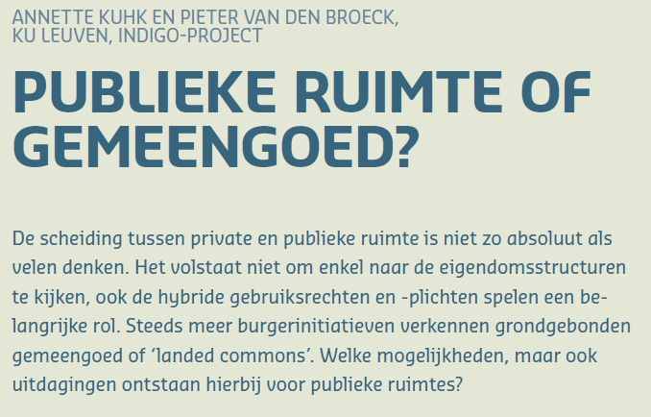
Workshop
door Annette Kuhk
en Sofia Saavedra Bruno

Slide 2

Publieke ruimte
=
Ruimte
in publieke eigendom
voor publiek gebruik?
V
OVERHEID
Grote verschillen
in eigendom
en gebruik
BURGERS
MARKT

Slide 3
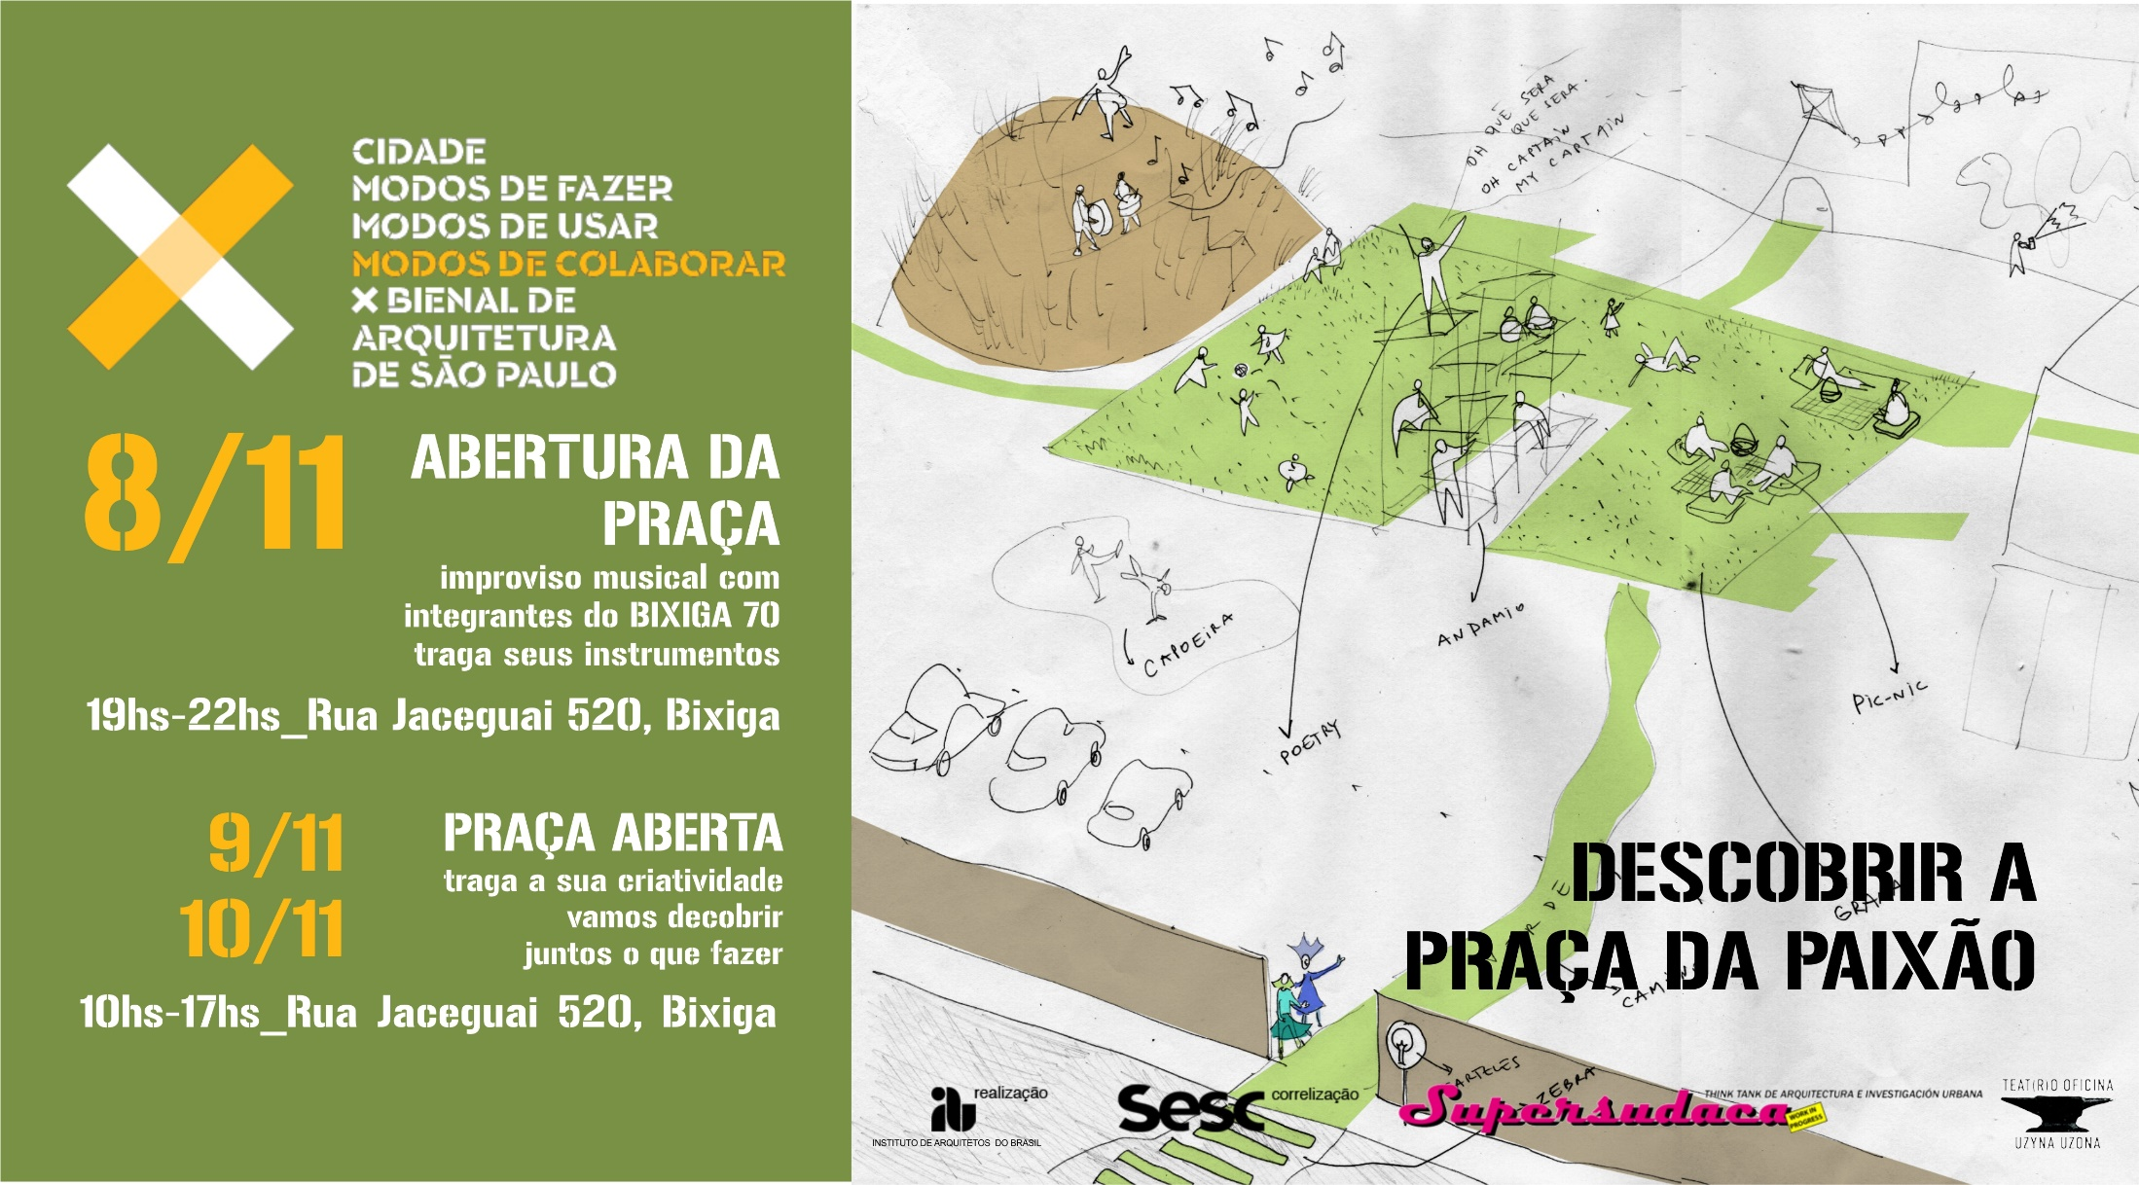

Slide 5
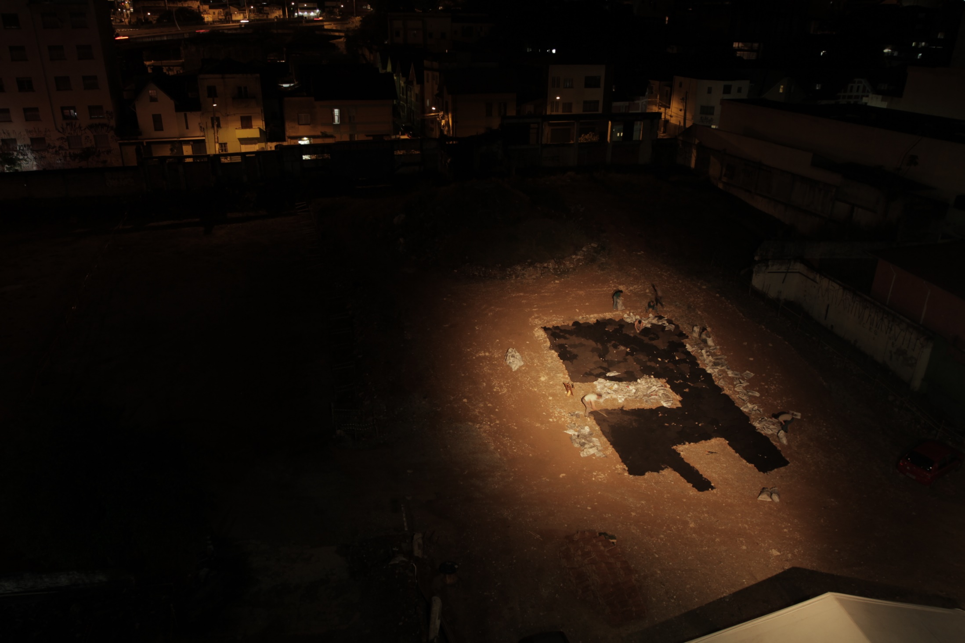

Slide 6
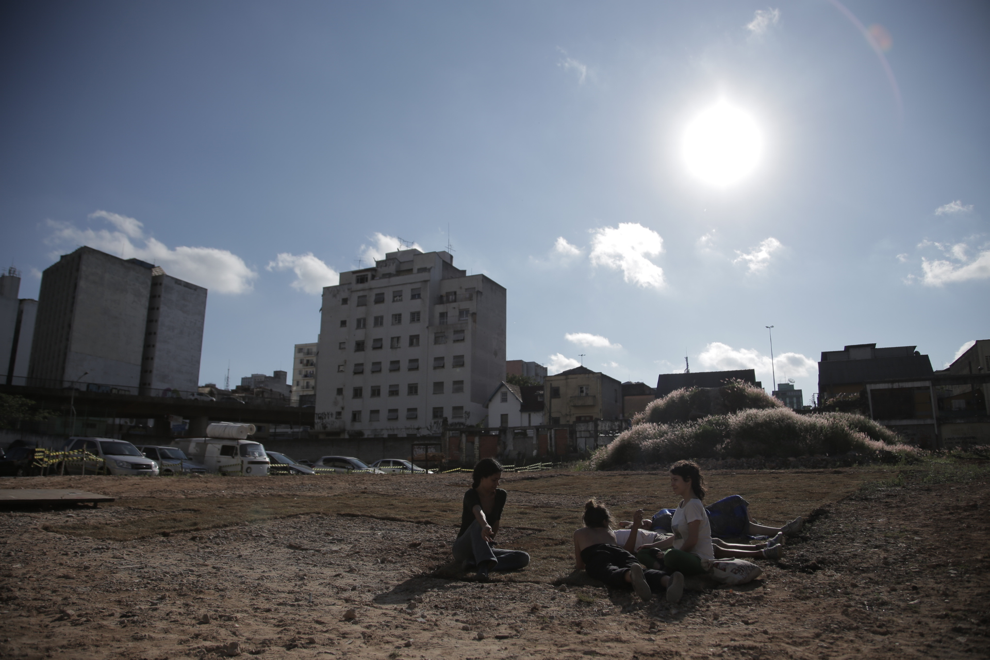

Slide 7
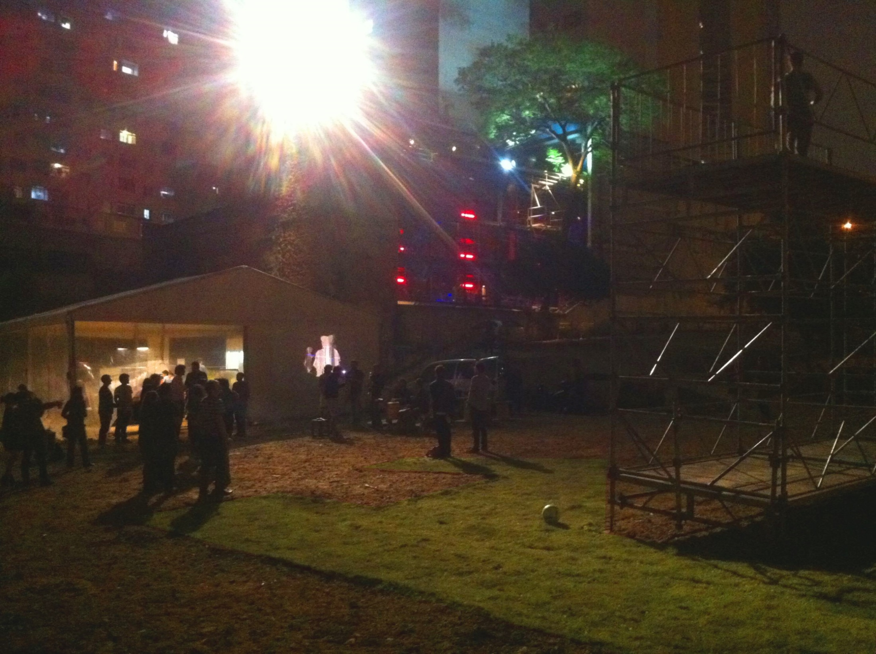

Slide 8
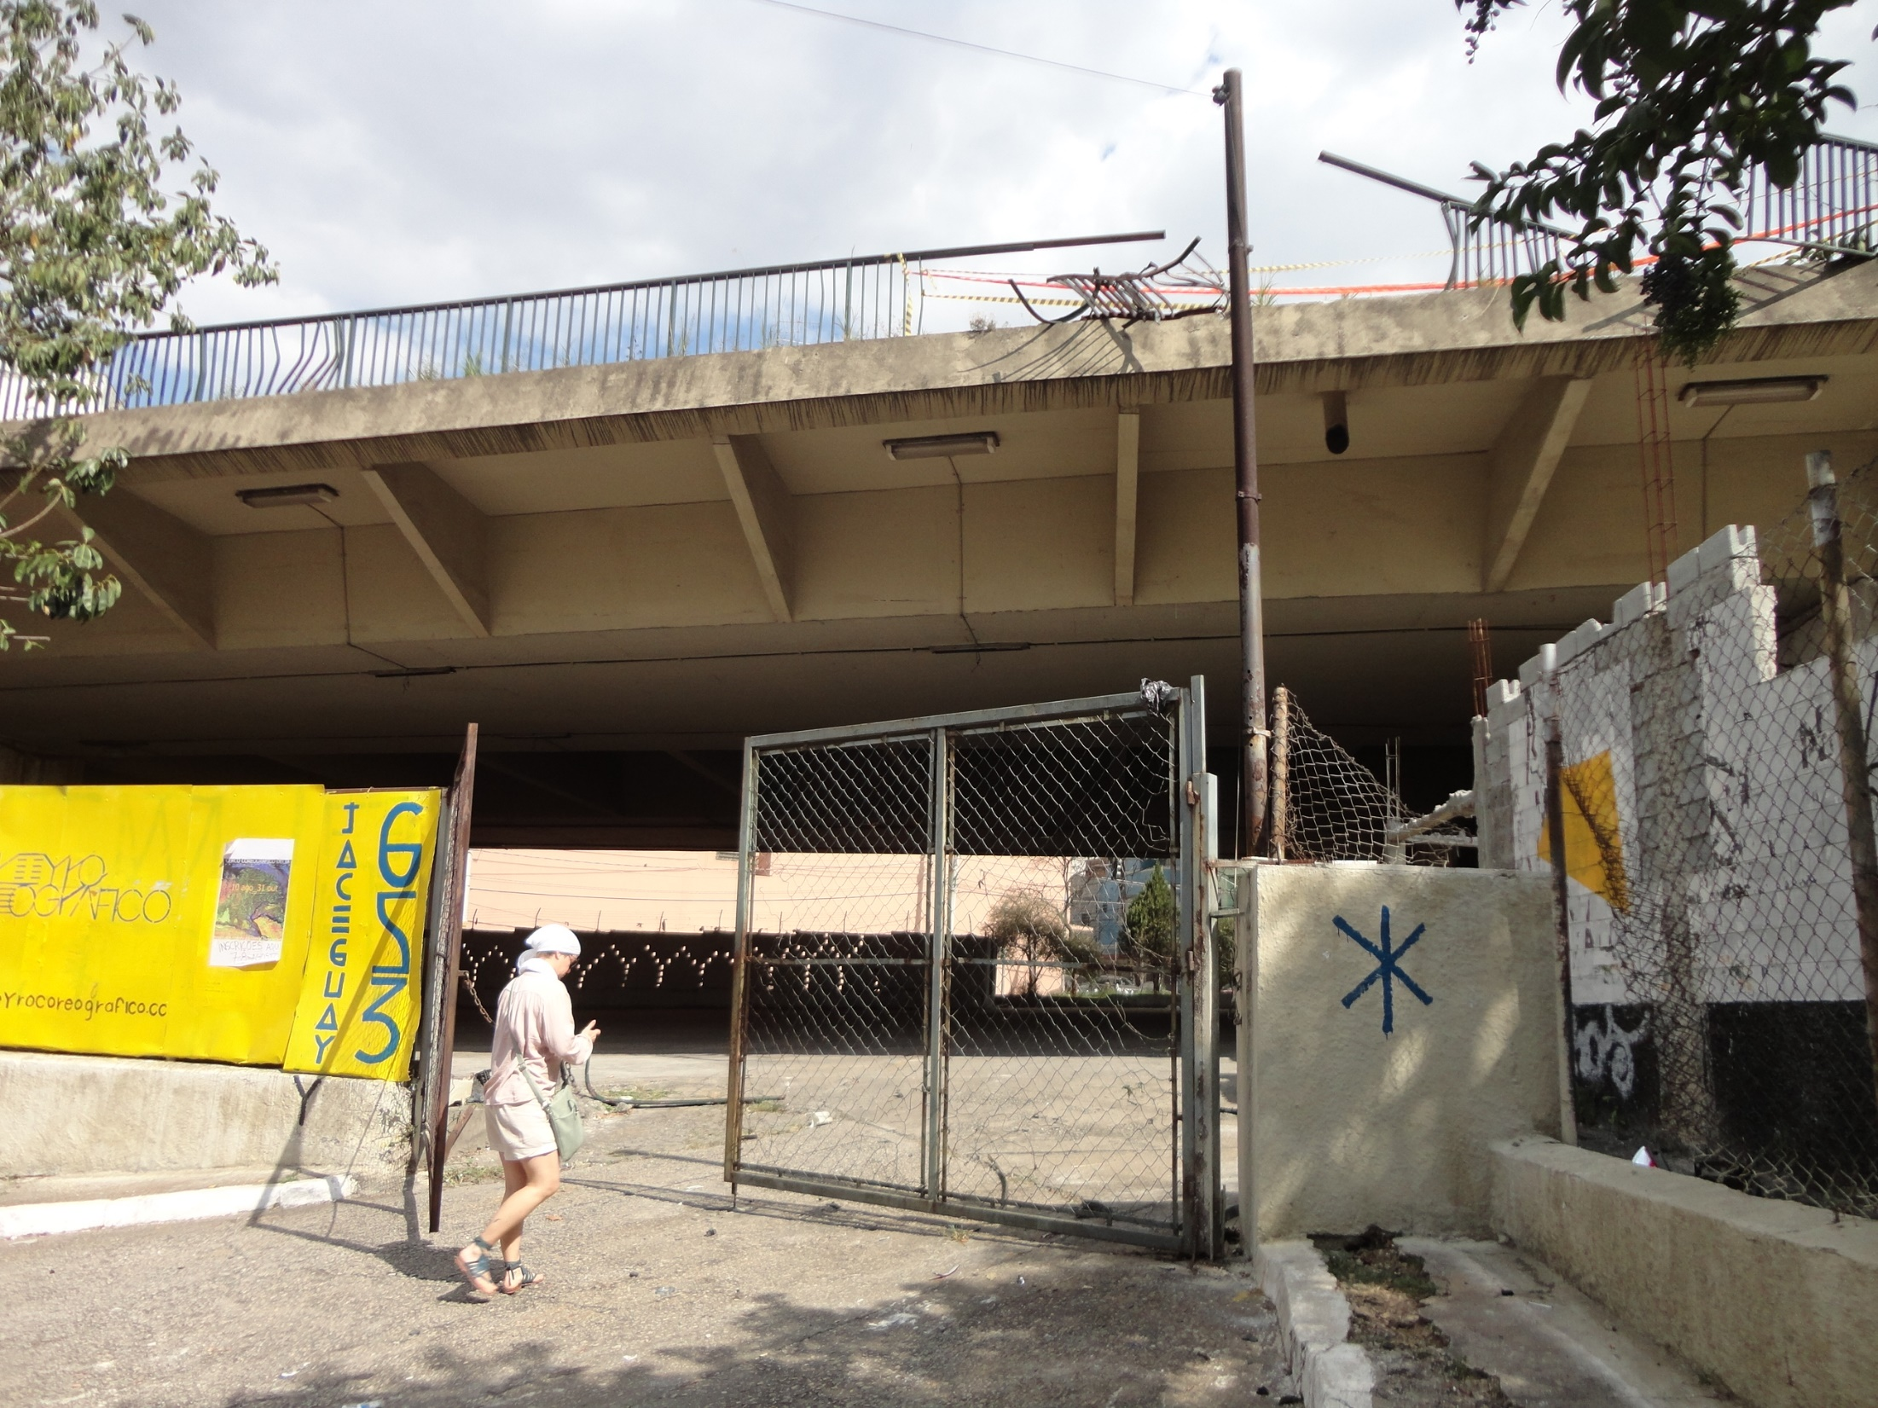

Slide 9
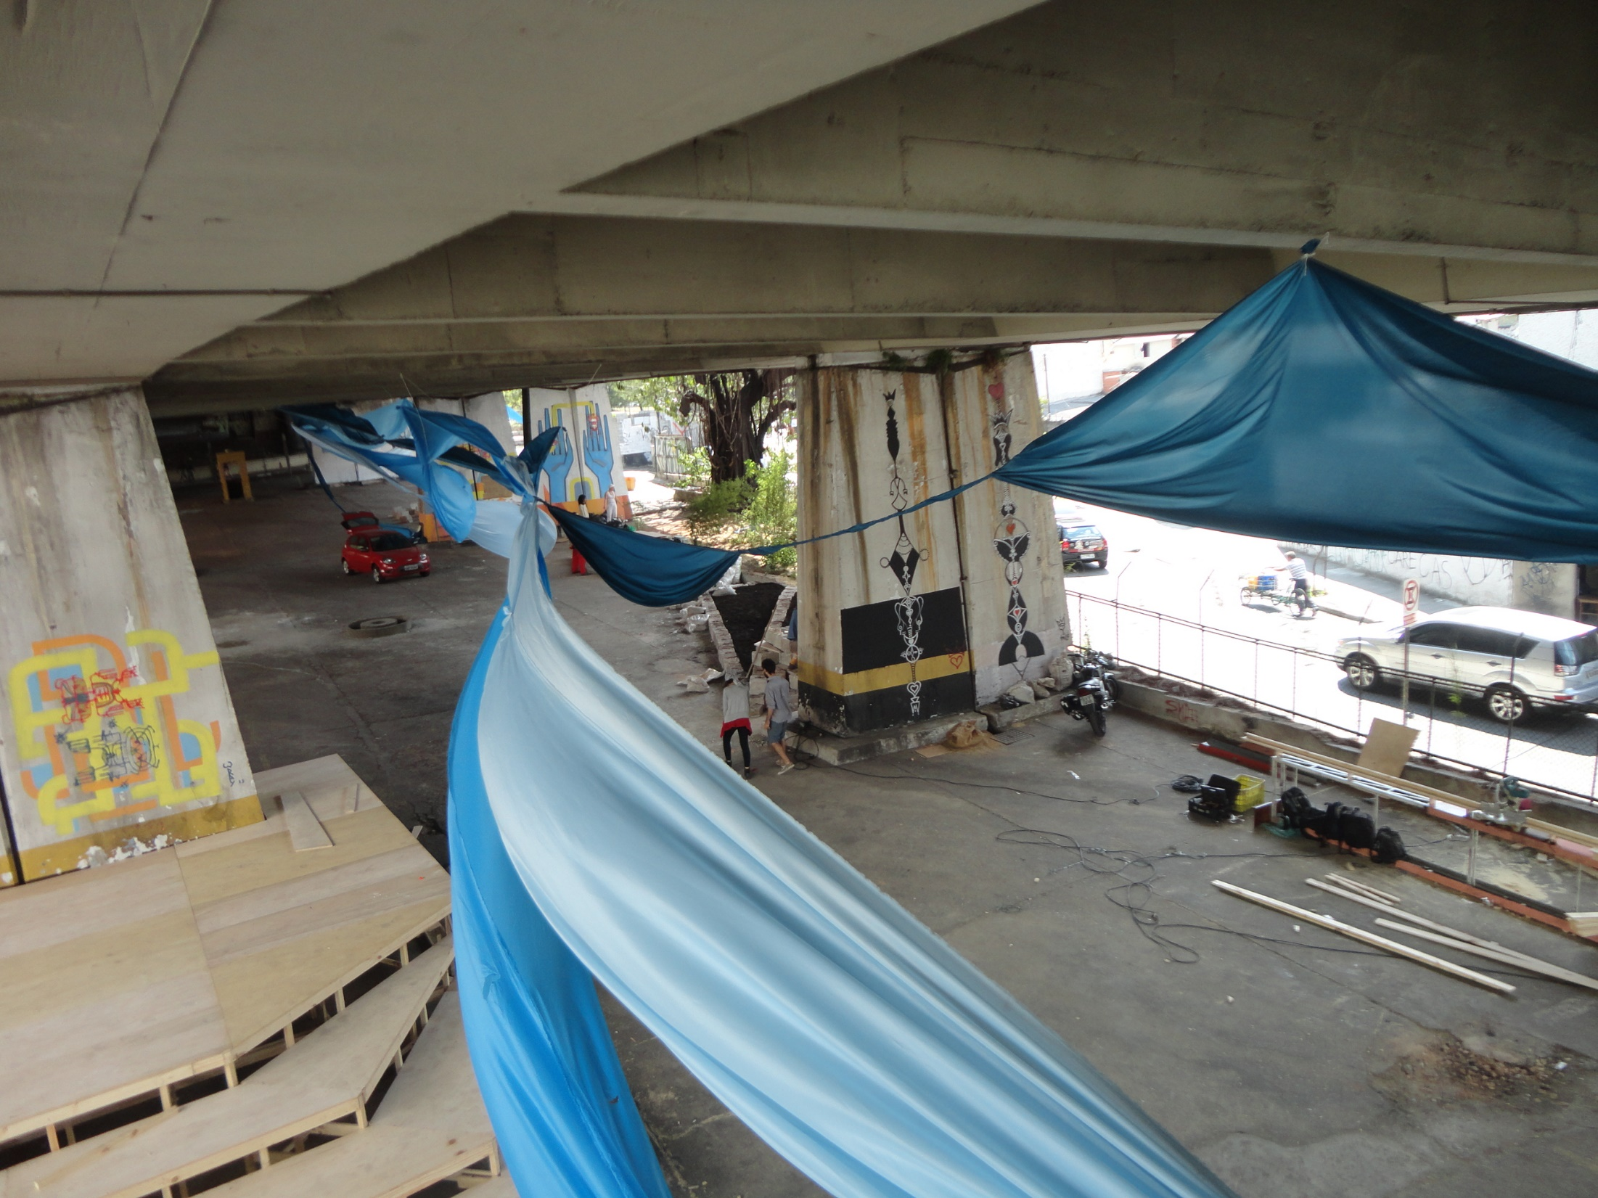

Slide 10
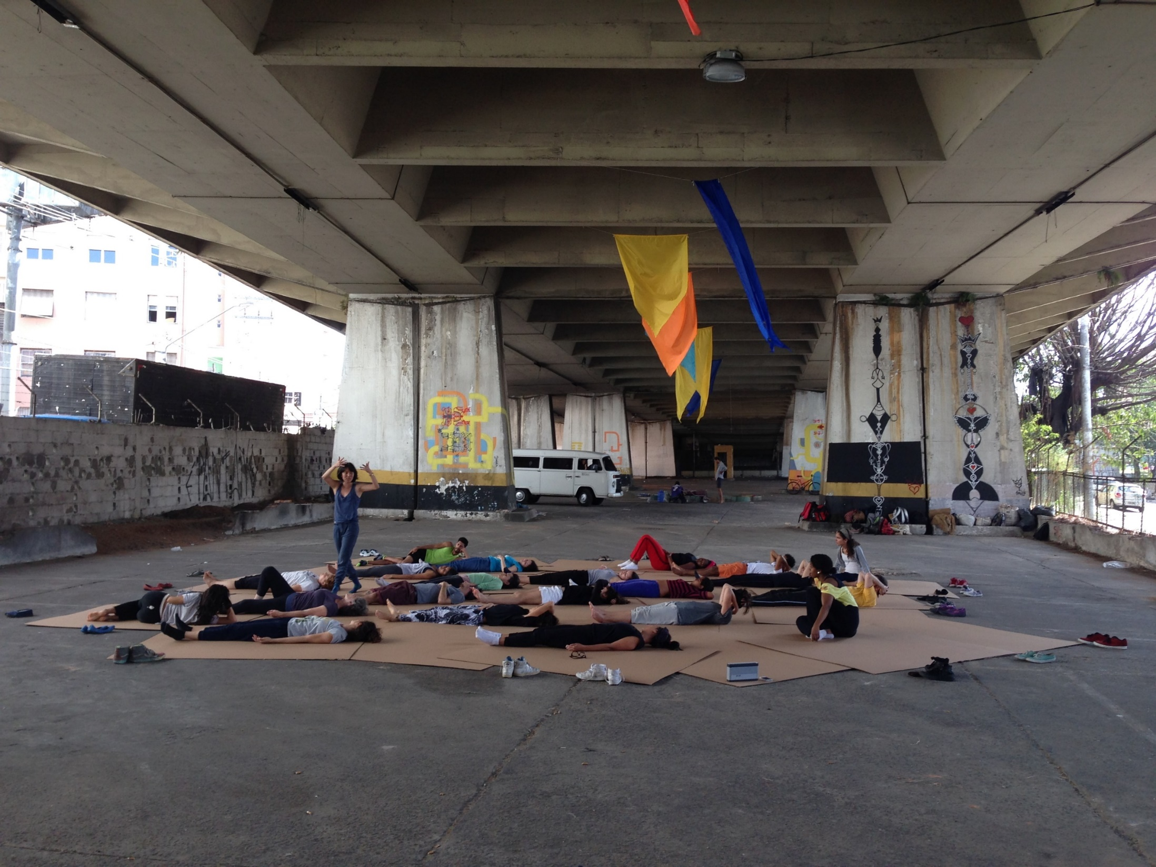

Slide 11
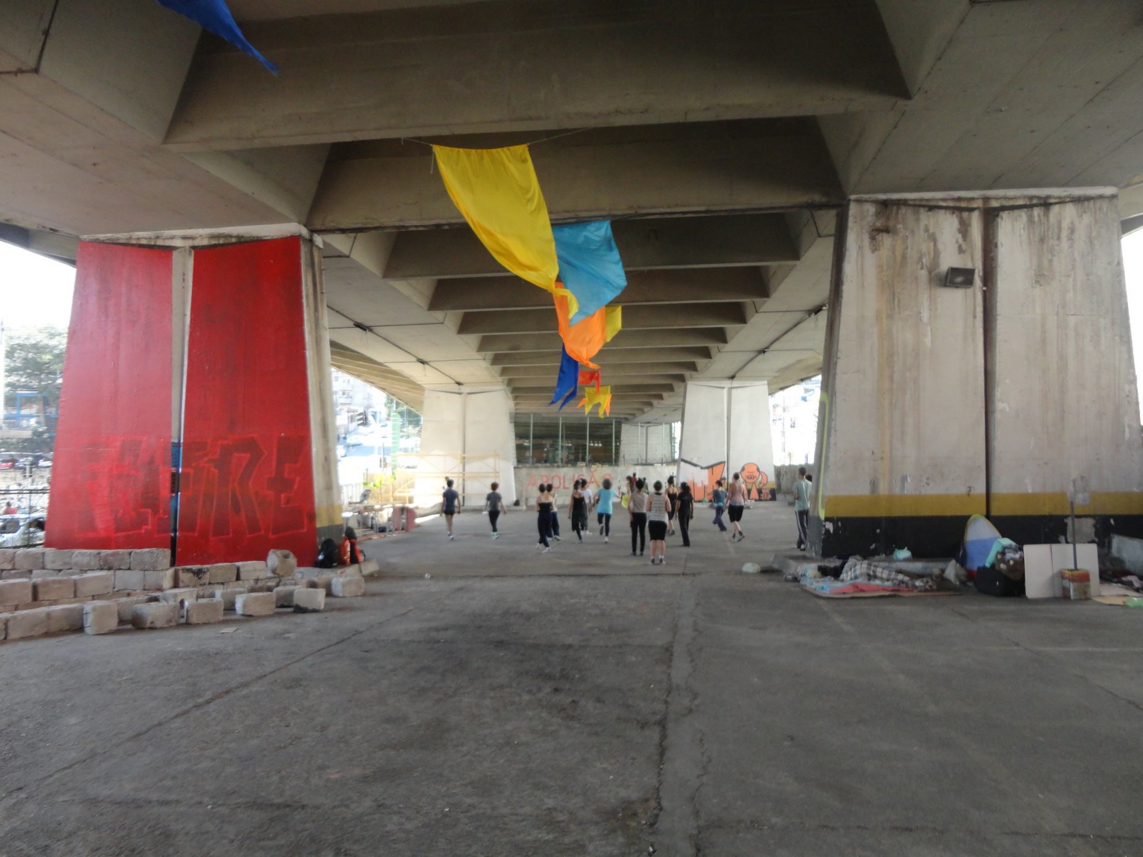

Slide 12
OVERHEID
publieke ruimte
publieke ruimte op private eigendom?
Commons in publieke ruimte
private eigendom
BURGERS
MARKT

Slide 13
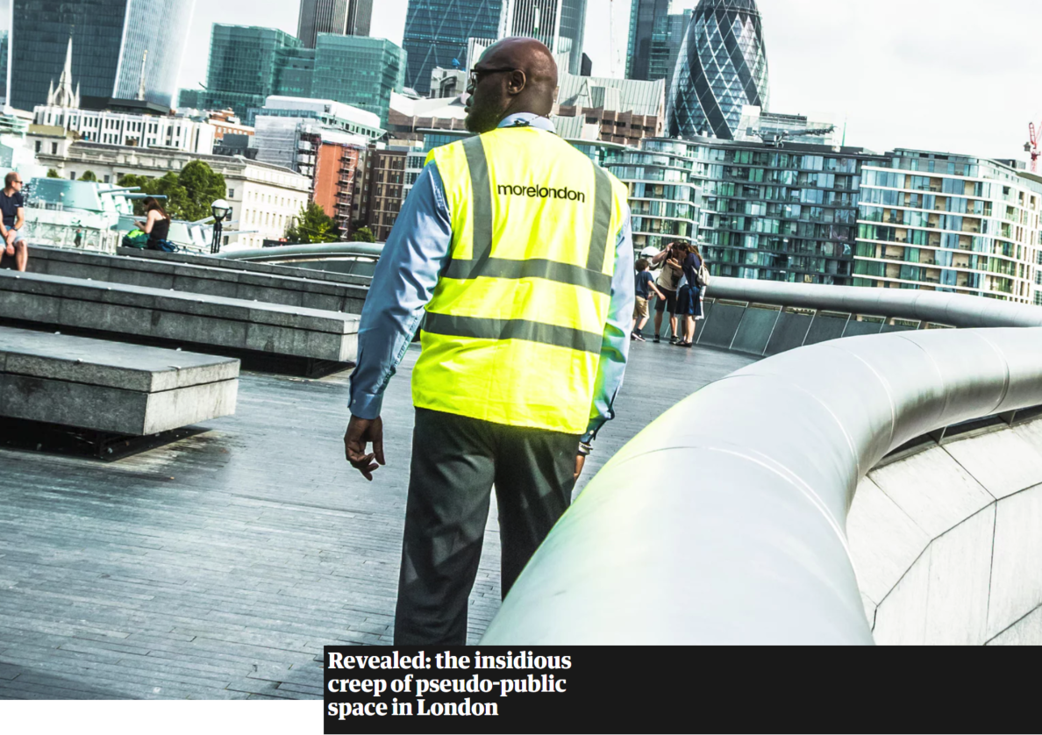
Artikel guardian
Notes:
Eigendom
Beheer
Gebruik
Privaat
Privaat
Publiek

Slide 14
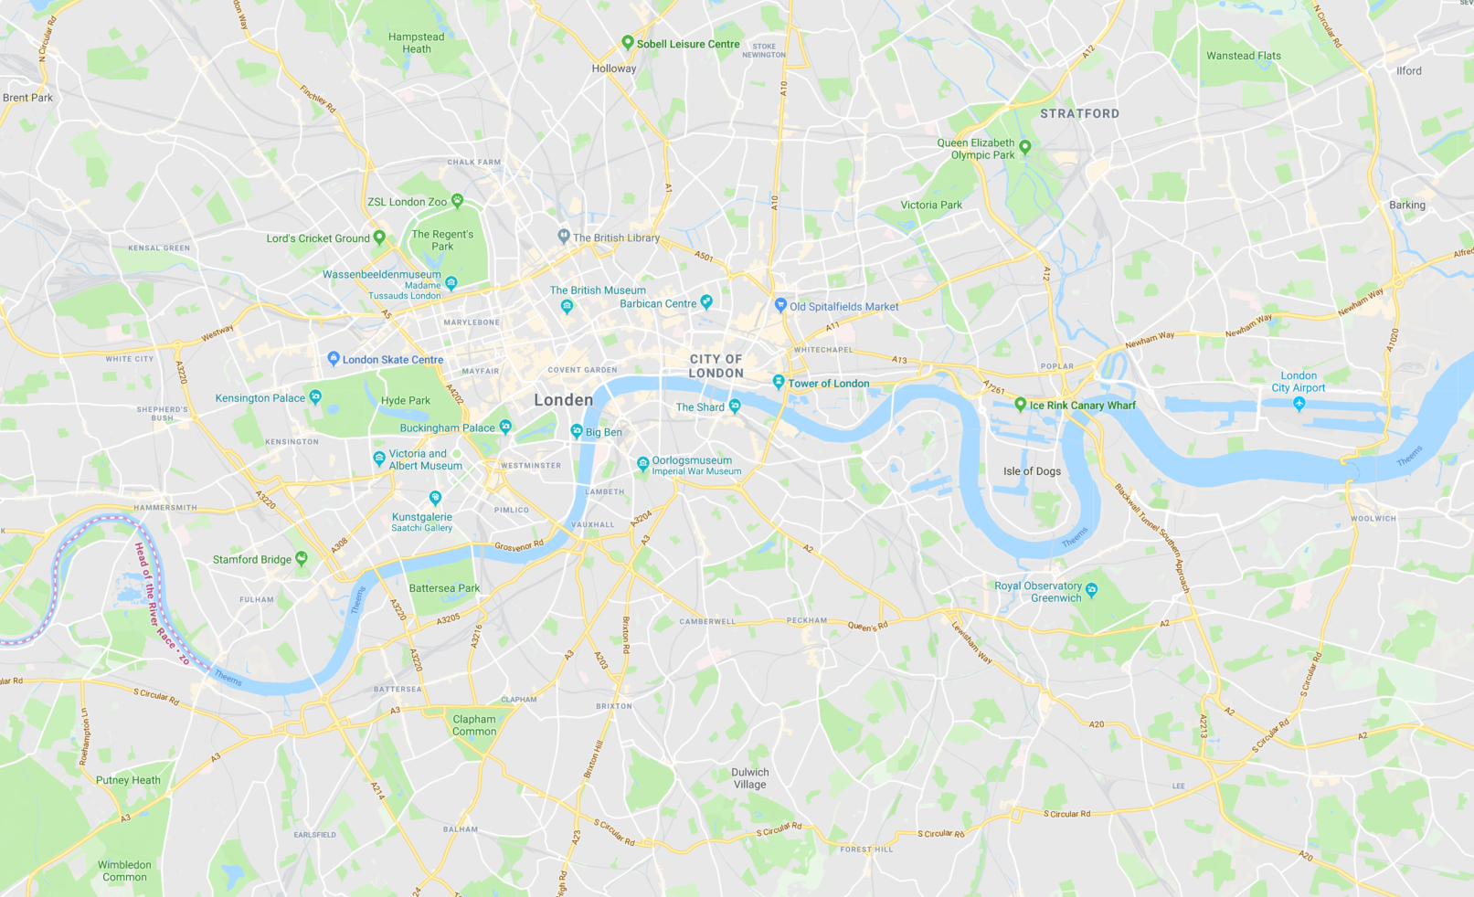
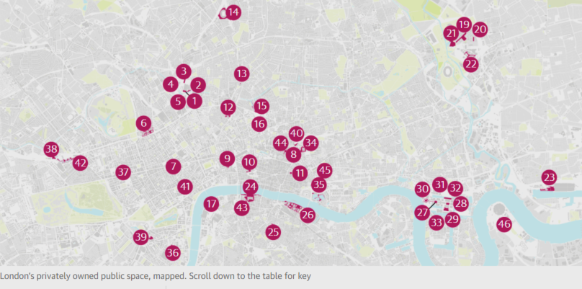
Notes:
Eigendom
Beheer
Gebruik
Privaat
Privaat
Publiek

Slide 15
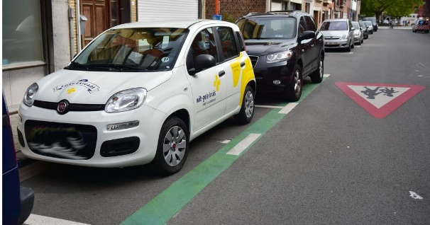

Slide 16
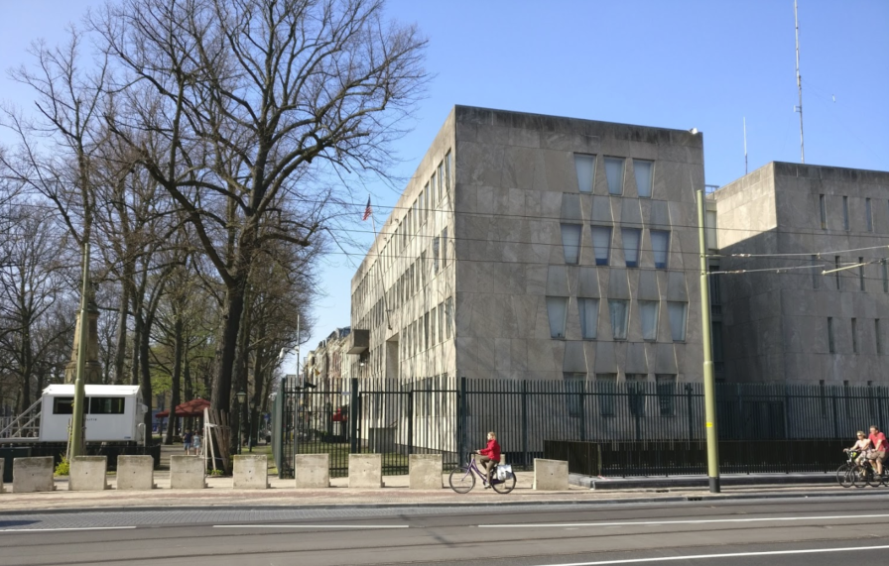
Voetpad voor de amerikaanse ambassade

Slide 17
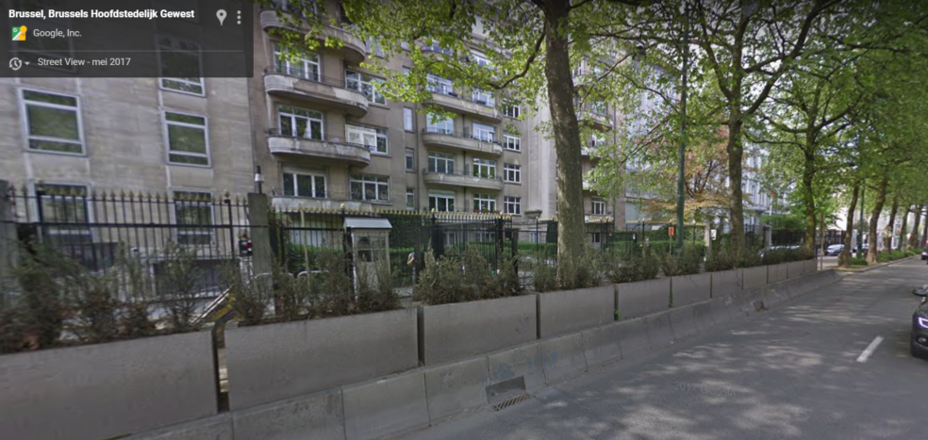
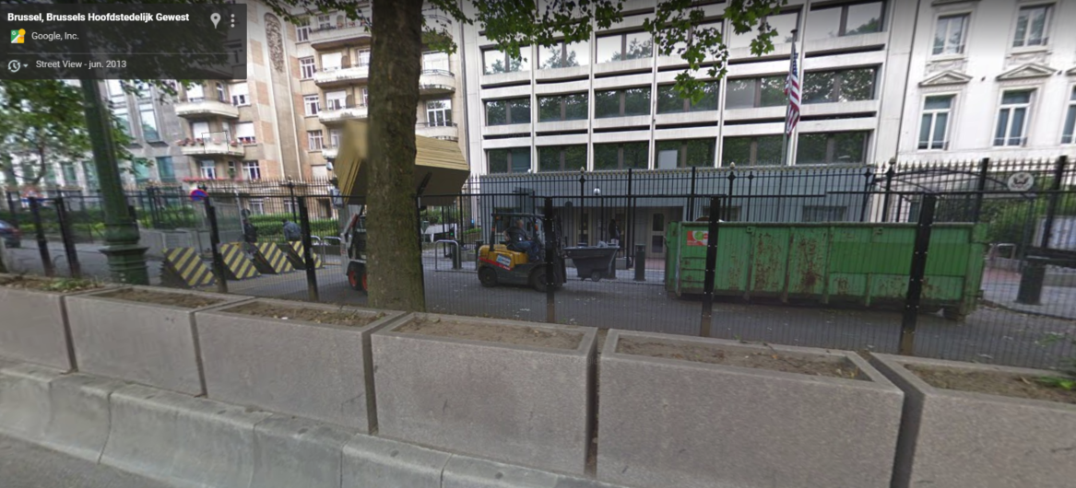
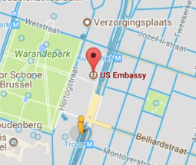

Slide 18
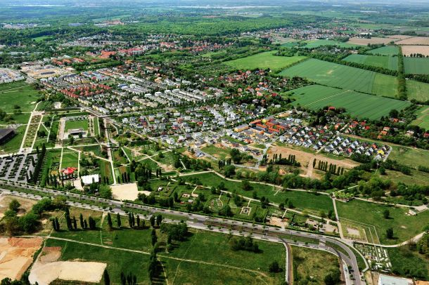
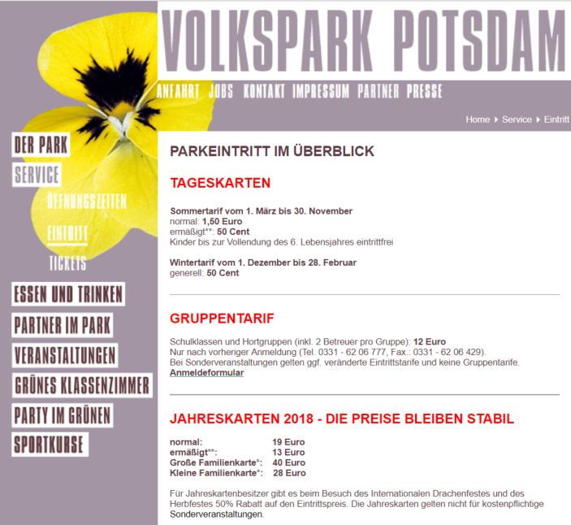
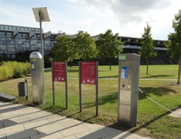
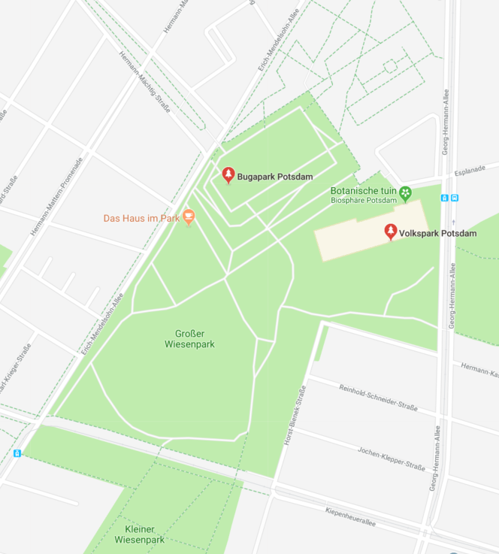
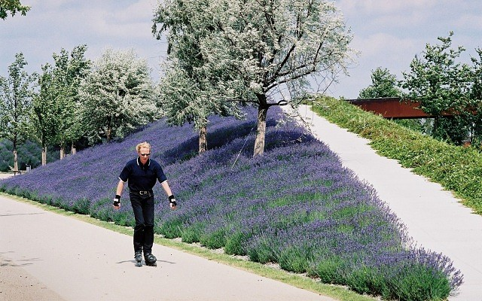

Slide 19
OVERHEID
publieke ruimte in publieke eigendom
publieke ruimte
maar privaat gebruik
publieke ruimte
maar geprivatiseerd beheer
publieke ruimte in private eigendom
BURGERS
MARKT

Slide 20
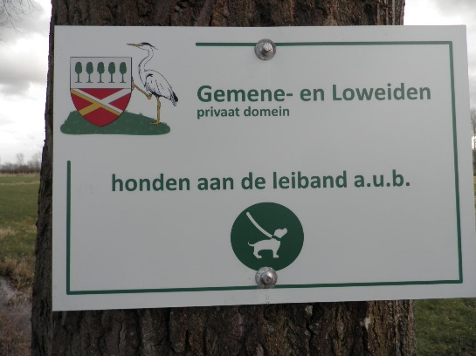

Slide 21
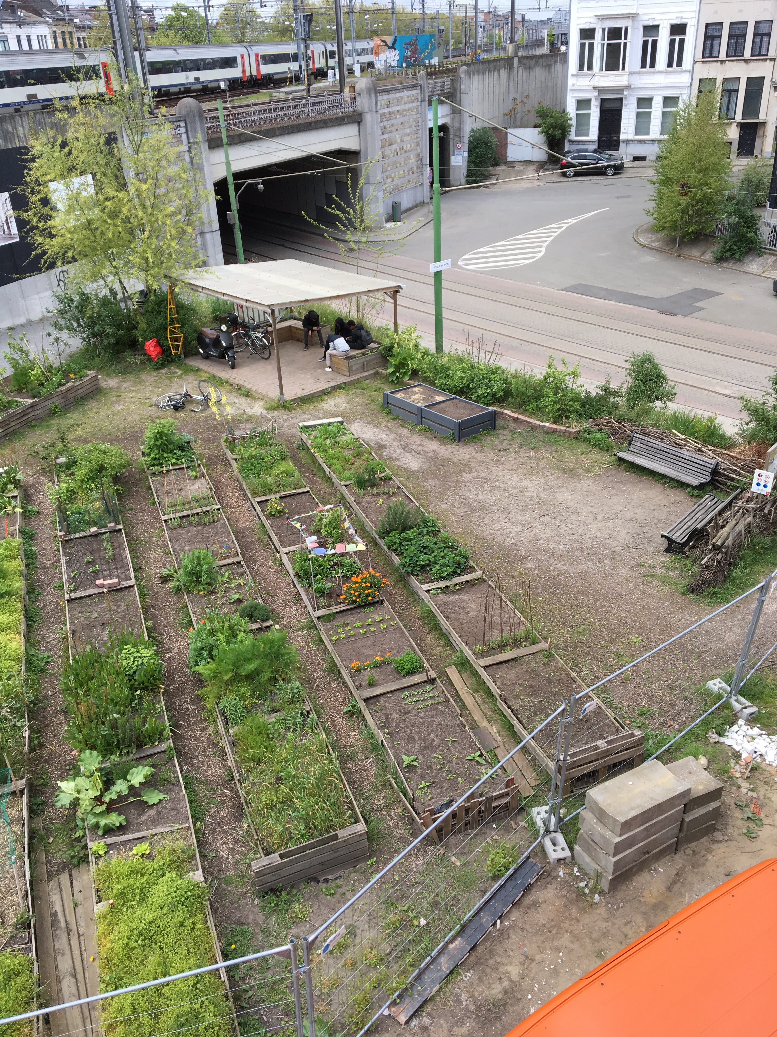
Guldenvliesstraat
Antwerpen Berchem

Slide 22
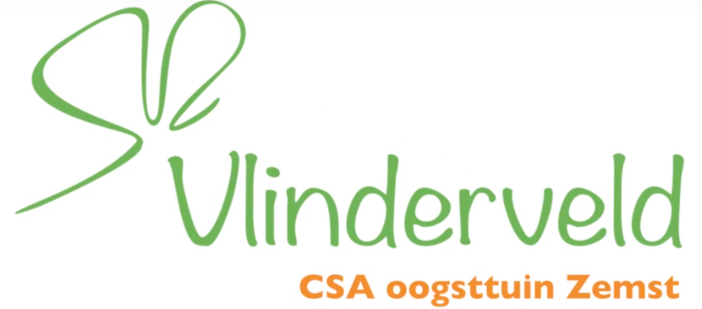
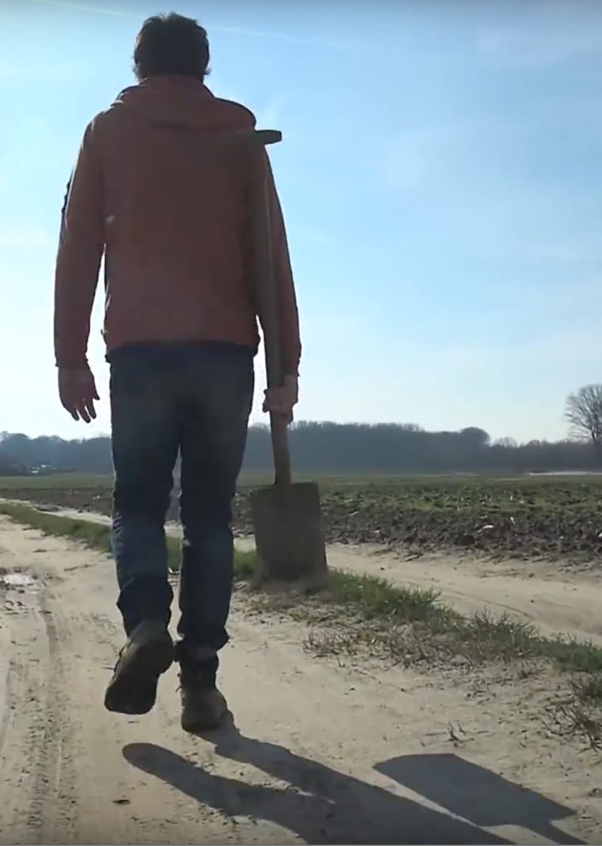
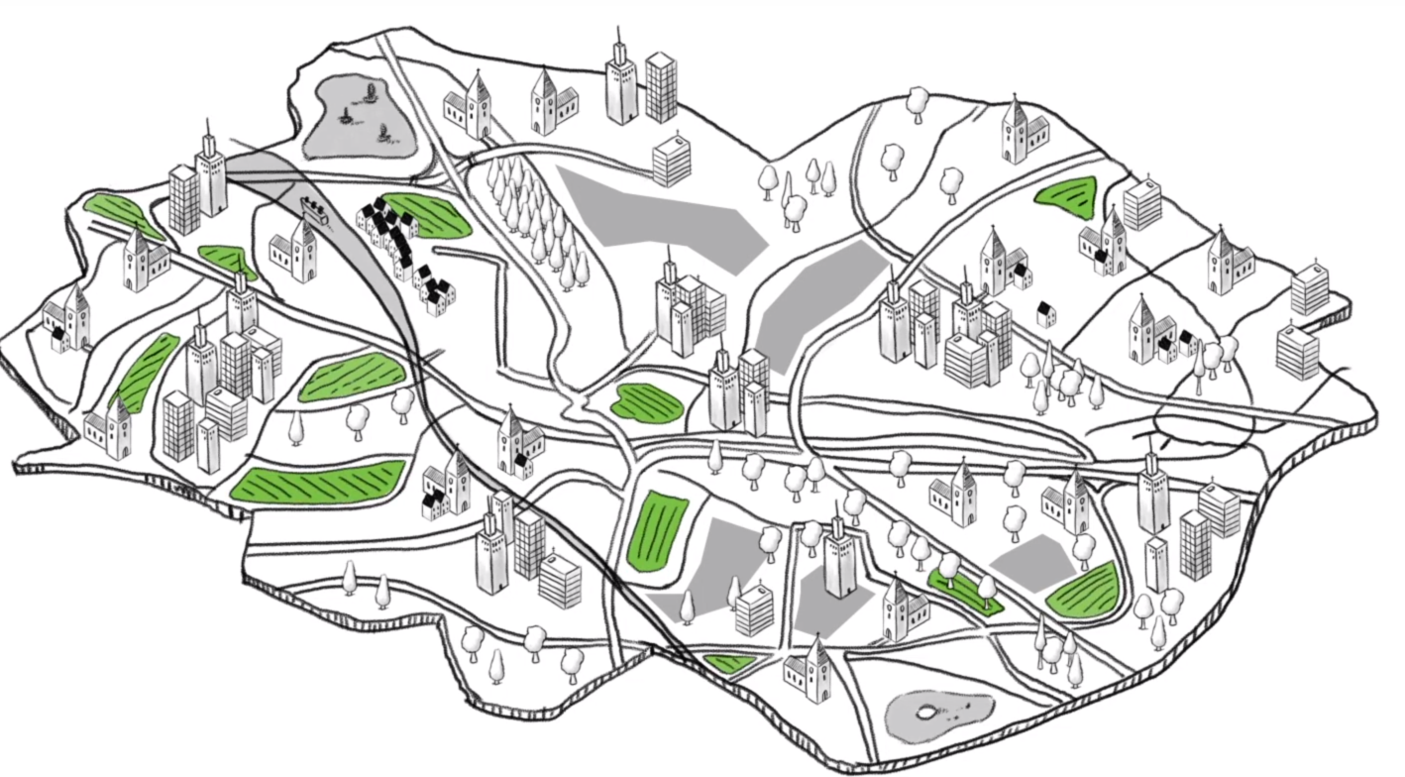

Slide 23
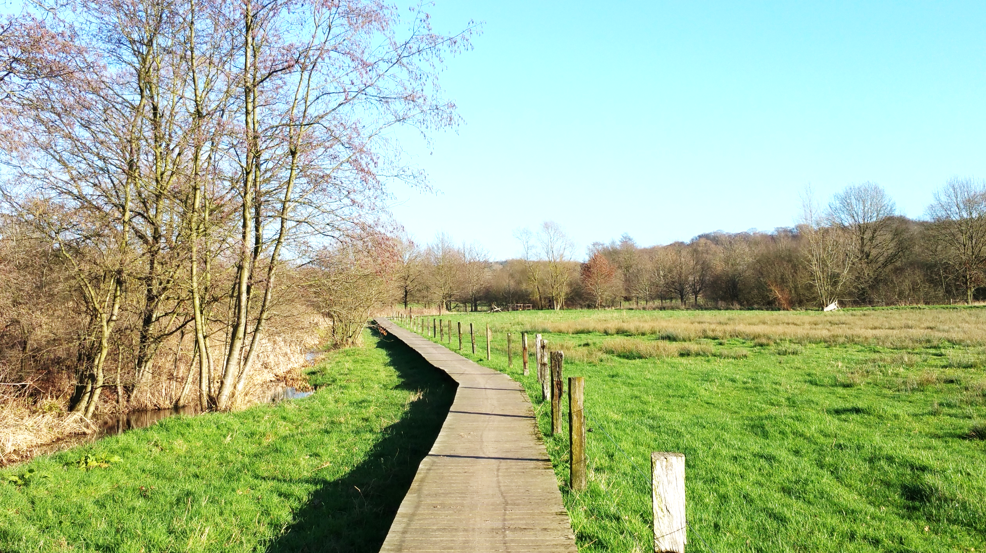
Trage wegen

Slide 24
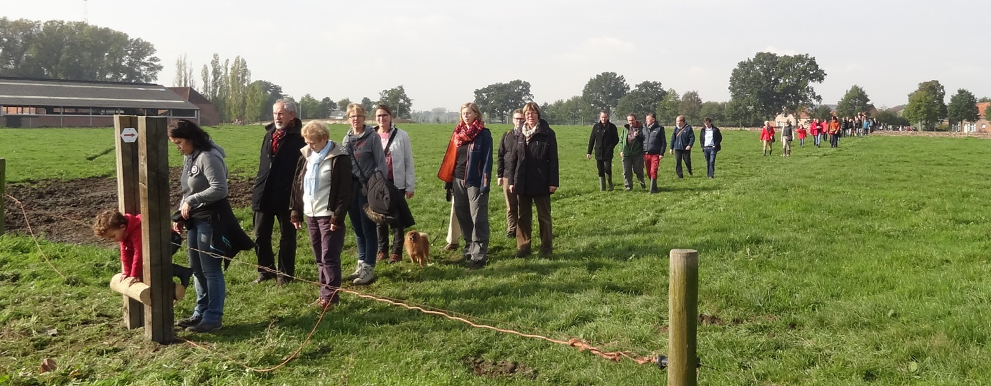
TRAGE WEGEN, RE – COMMONING van Open Ruimte
Van privaat eigendomsregime naar institutionele diversiteit
Analysing land use rights – Building Landed Commons
Sofia Saavedra Bruno/ KU Leuven
Notes:
-illustrate how (within fthe context of the INDIGO PROJECT) we used a specific analytical framework to examines several trajectories of negotiation and co-construction of new landed commons.
-INDIGO aims to understand
how land use rights can be collectively governed to foster the development of community-based shared land use patterns in Flanders
How Building and negotiation of Landed Commons take place, more specifically
-The case study I ll present today on is the shaping of Slow Paths as Landed Common in the South of Antwerp.
-Analytical framework: an action-research oriented version of the Théorie des Cités (TDC+) capable of (re)negotiating ownership regimes and land use rights in Combination with a list of Grand Principles defining landed commons.

Slide 25
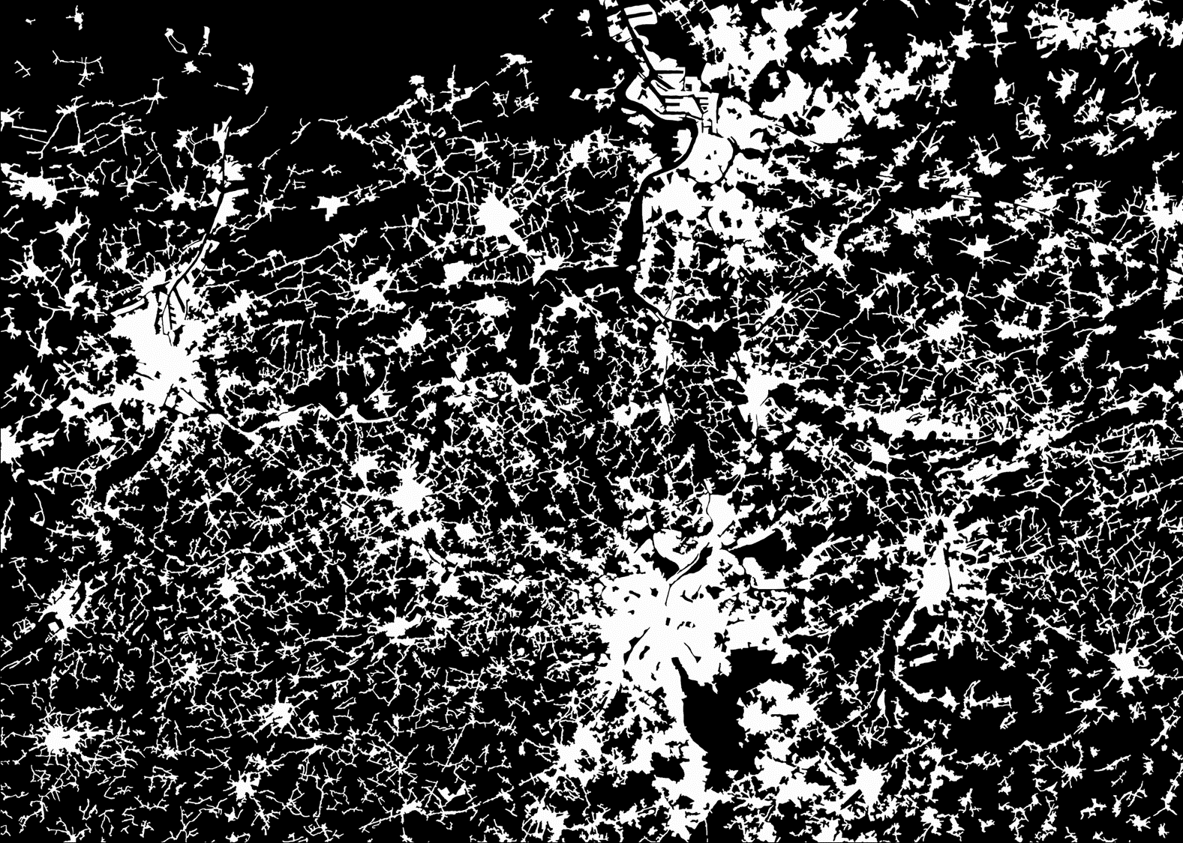
Privatisering, fragmentatie en aantasting van de stedelijke en landelijke ruimte in Vlaanderen
Bron: Presentatie Pieter van den Broeck, INDIGO SAC 28/11/16
Notes:
The PhD research explores a method to overcome detrimental social and ecological aspects of privatisation, fragmentation and encroachment of urban and rural spaces in Flanders.

Slide 26
Het Vlaams systeem van vergunningen is geëvolueerd naar private eigendom.
Bron:
Allotment permits in a rural community. Van Havre. D, 1967
In Spatial Planning in Flanders: Serving a bypassed capitalism? (Van den Broeck et al., 2014 )
Notes:
Research conducted by the Flemish Policy Research Centre ‘Housing and Space’ (Verachtert, Van den Broeck, and Kuhk 2011) shows how the Flemish planning permit system has evolved to favour private property through various interconnected mechanisms. De facto most if not all permit requests receive a positive answer from the planning administrations, making it all but impossible for governments to plan strategically for spatial development.

Slide 27
Maatschappelijke relevantie en urgentie van het INDIGO- onderzoek in Vlaanderen en daarbuiten.
Stijgende prijzen voor percelen in open ruimte
Verlies van open ruimte
Frankrijk: 60.000 ha per jaar, Vlaanderen: 2000 ha per jaar
Van wie is het land?
Land = investering, b.v. 45.000 ha in (Oost -) Duitsland zijn in handen van één bedrijf dat voor 9% in Chinese handen is. Dit bedrijf ontvangt ook openbare (en andere Europese) hulp.
Bron: Ppt Griet Celen, VLM, 20 jaar structuurplan VVRP, 17/3/2017

Slide 28
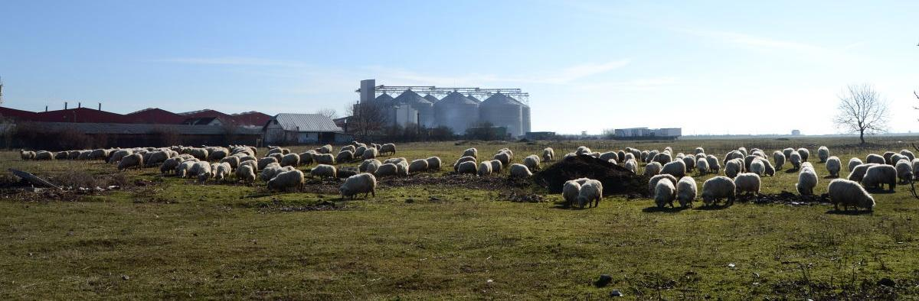
Reportage door Pieter Stockmans, voro MO*, over landroof, 9 maart 2018, https://www.mo.be/reportage/dit-een-oorlog-om-land-roemeni-het-slagveld

Slide 29
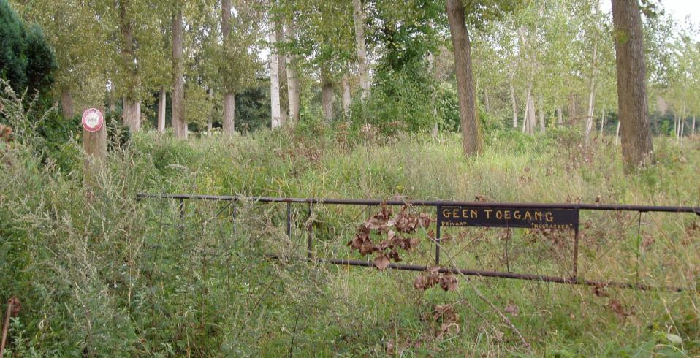
“
“The ongoing fragmentation in Flanders hinders governance practices that intend to stimulate the collective enjoyment of land’s diverse amenities by a diversity of people” (Verachtert, Van den Broeck 2015)
Notes:
It hinders governance practices that intend to stimulate the collective enjoyment of land’s diverse amenities by a diversity of people (Verachtert, Van den Broeck 2015)

Slide 30
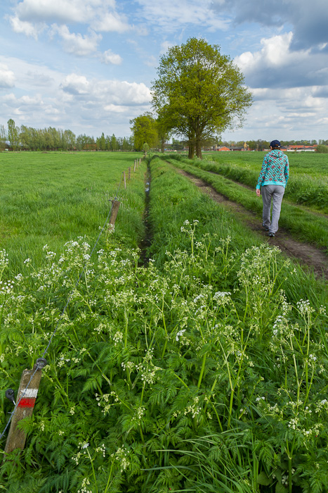
Trage wegen?
Kenmerken:
  Niet-gemotoriseerd verkeer
  Publiek karakter
    kerkwegels, bospaden, landbouwwegen, jaagpaden, 1-manswegen,
    oude spoorwegbeddingen
Verschillende statuten:
  Buurtwegen
  Feitelijke trage wegen
Notes:
De afgelopen maanden, jaren is er in verschillende gemeenten in de Zuidrand, jullie gemeenten, heel wat gebeurd op het vlak van trage wegen. Er is intensief gewerkt aan dit netwerk van wegen en paden voor niet-gemotoriseerd verkeer maar met een publiek karakter. In dat netwerk onderscheiden we een belangrijke categorie nl. de wegen uit de Atlas der Buurtwegen maar ook heel wat feitelijke trage wegen met andere statuten horen bij dat netwerk. Waarom is er gewerkt aan de versterking van dit netwerk? Omwille van de voor de hand liggende voordelen die trage wegen hebben. Ze zijn belangrijk voor onze (duurzame) mobiliteit, ze zorgen voor lokale ontspannings- en recreatiemogelijkheden, ze maken soms deel uit van historisch erfgoed en ze hebben voordelen voor planten en dieren.

Slide 31
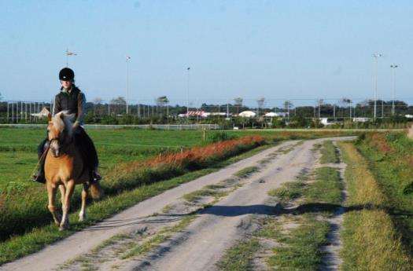
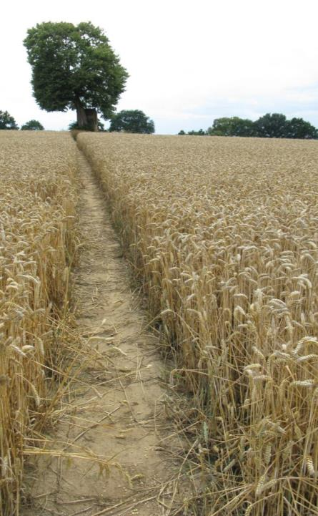
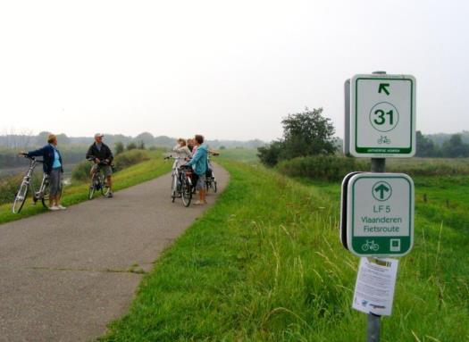
Notes:
Trage wegen zijn wegen voor traag verkeer: fietsers, voetgangers, ruiters…
Duizend vormen: breed en smal; verhard en onverhard; in de stad en op de buiten en in het bos

Slide 32
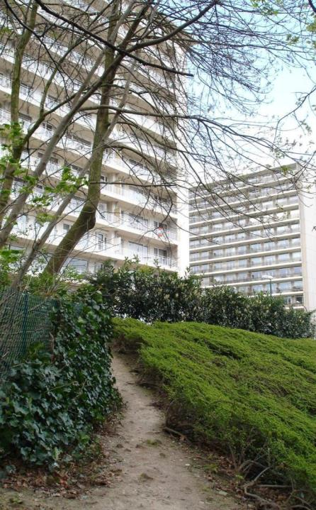
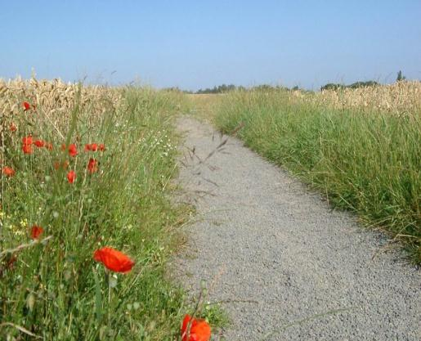
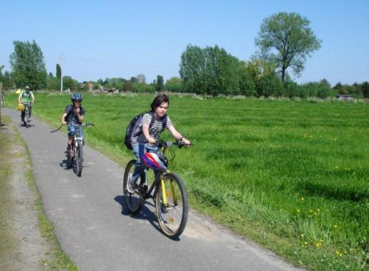
Notes:
Stedelijke context versus landelijke context:
Mobiliteit (schoolgaande kinderen) maar ook: recreatie, natuur

Slide 33
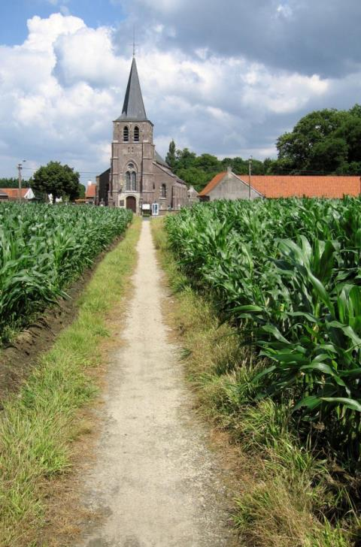
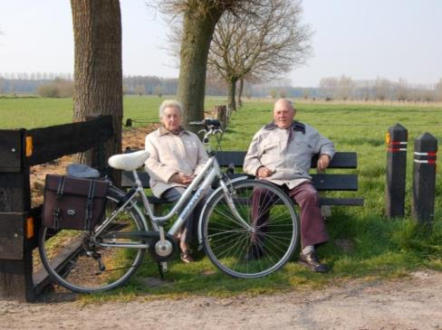
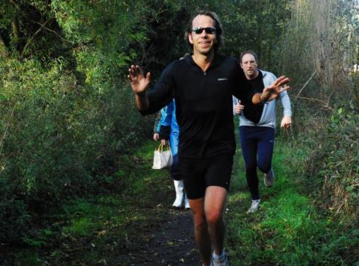
Notes:
Ook: erfgoed (kerkweg); landbouw; ontmoeting; sport (wandelen, joggen, mountainbiken)

Slide 34
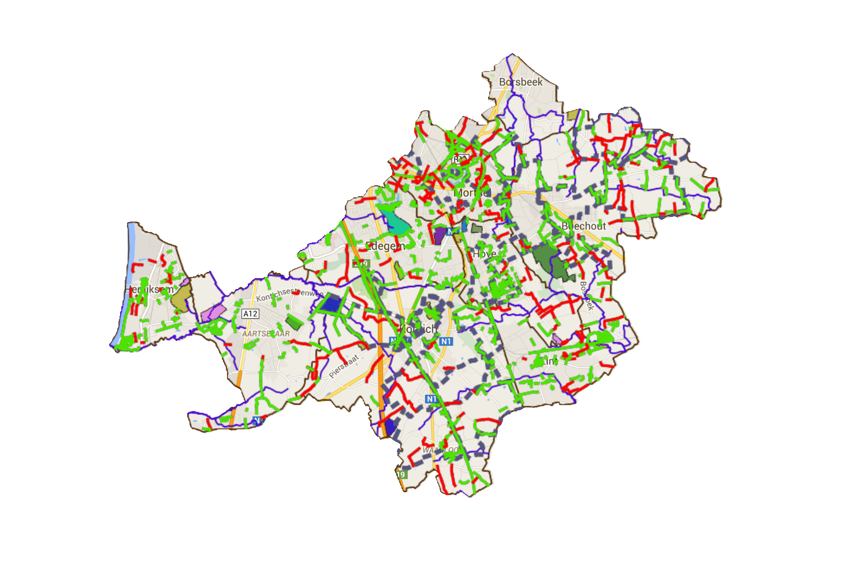
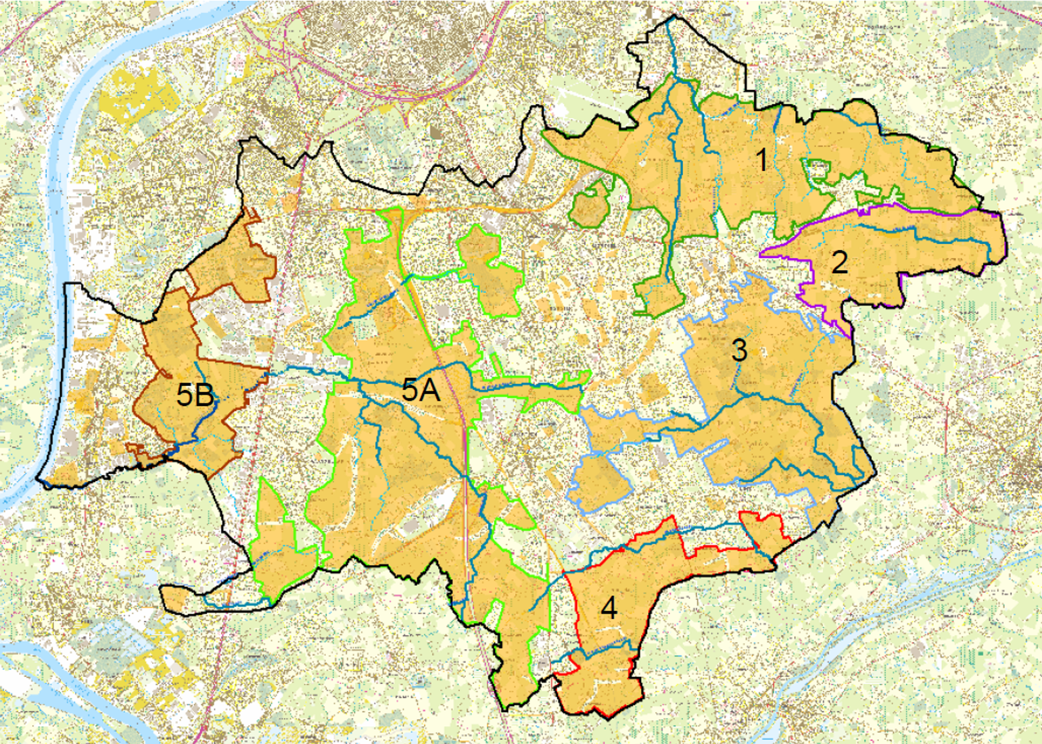
|Landschapspark Zuidrand
Trage wegen als centraal project bij het regionaal landschap
"Capillair systeem in de open ruimte, waardoor het voor het publiek toegankelijk en plezierig is, en afgesloten ruimtes opent”
Hoofse Hoek
Supralokale verbinding “Hoofse Hoek”
als een pilootcase
Notes:
To study the proces of recommoning or how commons are build and negotiated we analysed the creation of a networks of slow paths in the South of Antwerp.
Slow paths have been advocated from the beginning by an ngo as a reaction against the motorization and privatisation of public space and today specifically against the lack of open space (2000 ha disappears everty year) and ongoing privatisation, fragmentation and speculation of urban and rural land the slow paths have become of vita importance as connectors for open space. The lead idea of LZ is that they can serve as oxygen for open space and should be preserved. Over the years there was a shift rom preservation to expansion and integration of networks , fe in the project for the creation of a regional landscape in the south of antwerp. In this project Slow paths have been interpreted as a “capillary system to the open space, making it accessible to and enjoyable by the public, breathing life into closed-off spaces”.
We will nevertheless only focus on the creation of supralocal connection ‘Hoofse Hoek’.

Slide 35
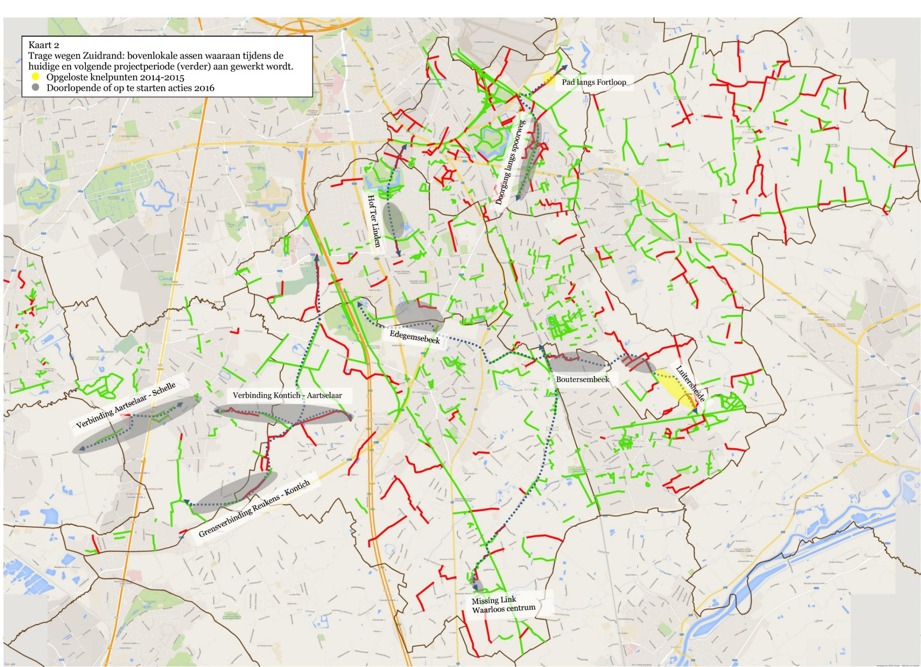
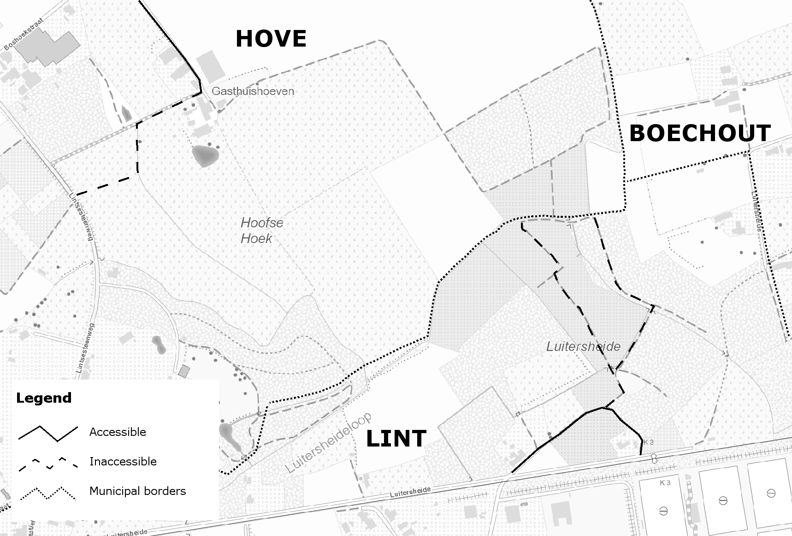
Supralokale verbinding
= QUICK WIN

Slide 36
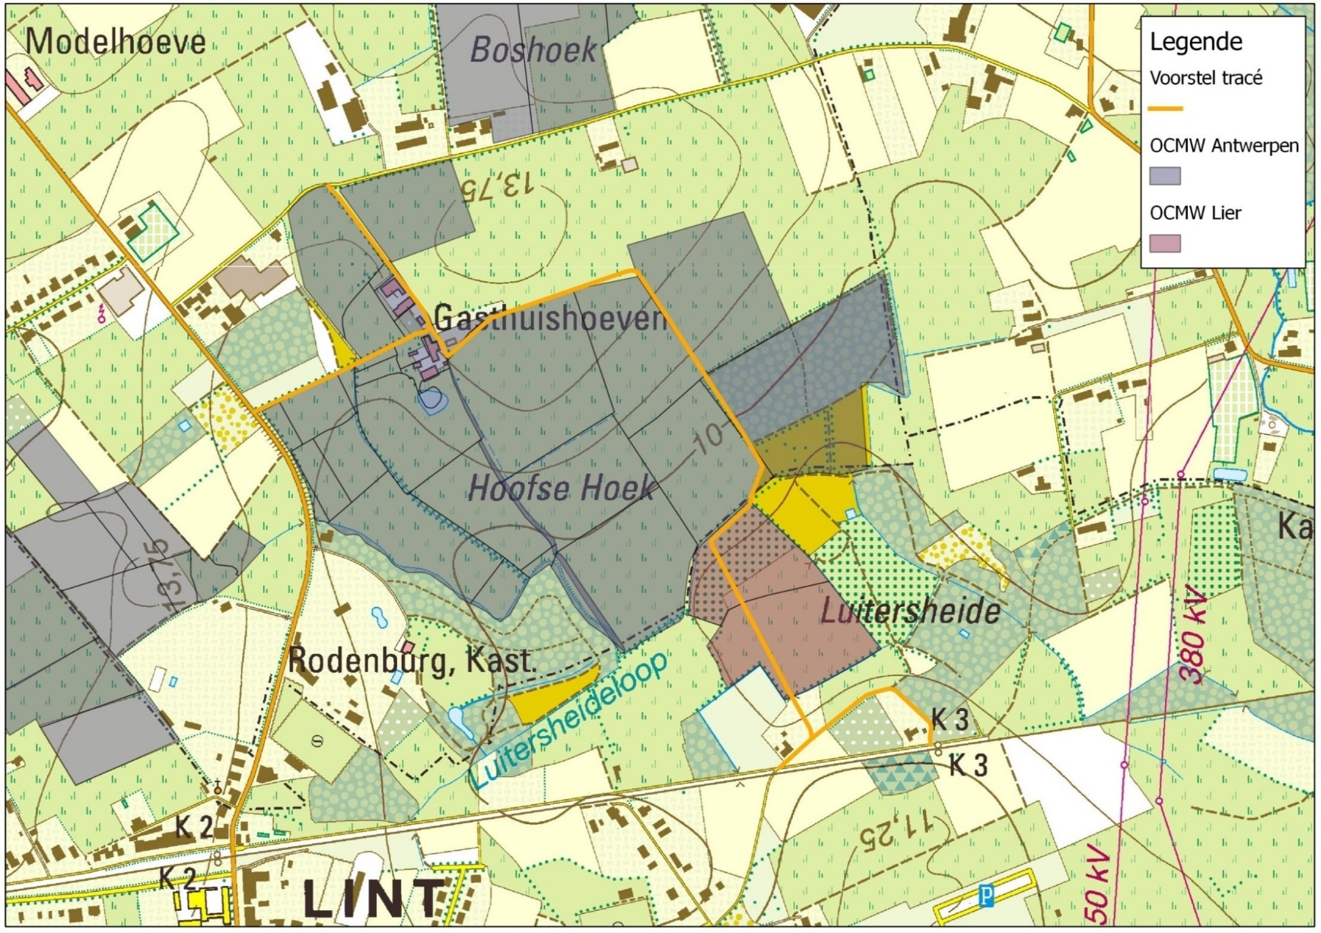
1
Notes:
This is the moment in which the first trajectory is defined

Slide 37
Project logic: participation & consensus, achieving ‘quick win’
CAP, PAS, tenancy regulations
Path as a lever
OCMW Decree, OCMW decision & vision, tenancy regulations
Hove Tenants
“Missing Link” connection
2003 Decree on Water management
Project team
Personal relations, change
mediator
Creating a project team
OCMW forest ranger
Civique
Marchande, écologique
DIW
Marchande & domestique
Civique
2012
2013
2014
2014
2015
2016
2012
September
2013
August
February
2015
June
2016
August
February
January
May
May
November
August
January
March
July
September
March
August
January
ANB accessibility advice
Confirmation of trajectory
civique & marchande
OCMW sale, CAP, PAS, tenancy regulations
Mecenas
Identification as ‘Quick Win’
Marchande, domestique
Civique
Adjacent land user / farmer
OCMW Lier project co-ordinator
Hunting regulations & practices
Hunter / land owner
Well-known figure
OCMW Decree, OCMW decision & vision
Marchande
Pension
Notes:
Lastly, the two bigger land owners – social welfare organisations from Antwerp and Lier, were present. OCMW Antwerp, who put the land of the tenant on sale, was captured by a legal duty to sell lands publicly, on the market. However, that cité marchande decision was softed somewhat through their forest ranger, who was partly unaffiliated because of personal affection for the current users, and sought to create an easy transition for them, acting from a cité domestique approach.
OCMW Lier lastly owned the public forests through which the path ran. The representative was easily found to consent, which derived from a lack of interest due to a lack of vision of the organisation on their patrimony as well as the fact that she was soon retiring, and probably not wanting to create a fuss. Therefore, a cité civique (sticking to proper administrative conduct) was elected.

Slide 38
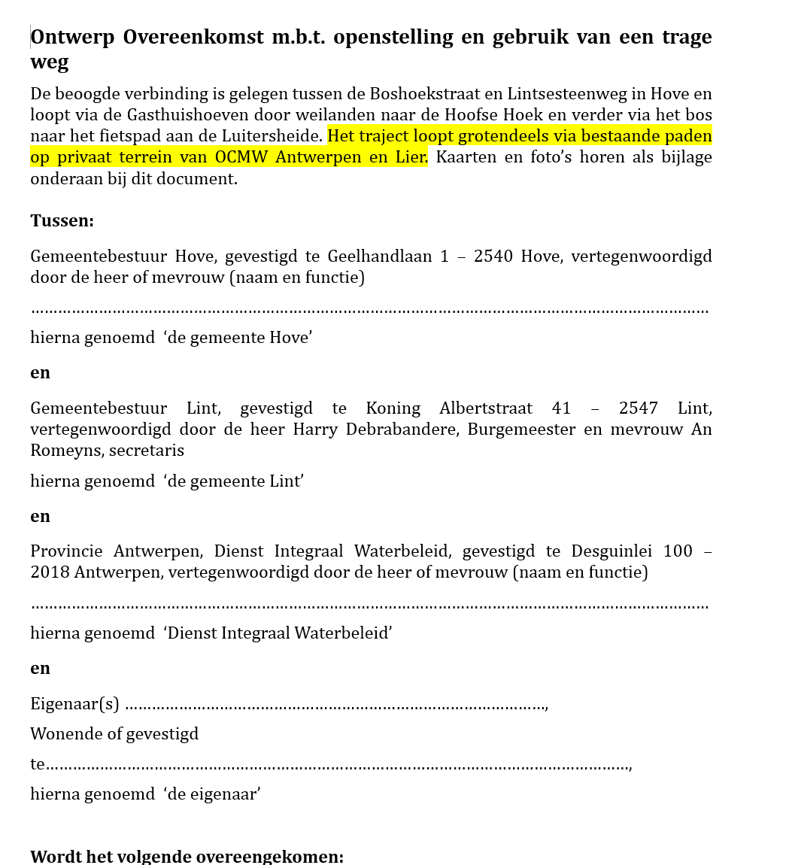
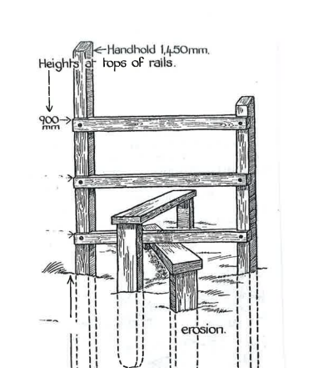
“Missing Link” connection
Building a community, involving users and owners
Project team
Contesting passage: hunting practices & private property
2012
2013
August
2014
February
2015
June
2016
March
July
November
September
August
January
Shaping resource use: construction
Developing governance tools: user agreement, public easement
Negotiating Use Package
‘Quick Win’
Notes:
Therefore a use package needed to be negotiated that lead to a contract between the 2 municipalities, the province and the landowners, stipulating things such as the constructions along the path, the use and maintenance rights, the agreements that settled those.
In this phase you see the emergence of resistance and conflict, such as with hunting practices, as well as tensions as a countering trend trying to establish a sense of community among the various land owners along the path. Among among the tenants/farmers where the psychology of interpersonal relations played a role

Slide 39
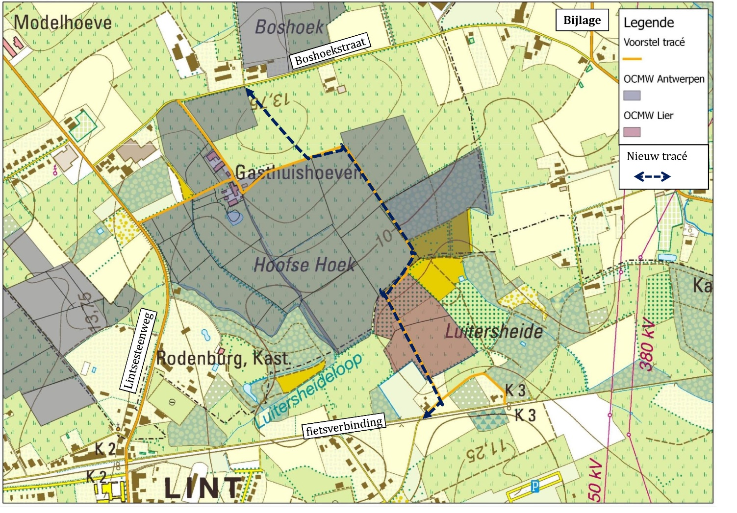
3
2
1
Notes:
New

Slide 40


Slide 41
 | ‘Grand principles of the landed commons’
1 | collectively agreed or mediated system of diverse land use rights, practiced individually, jointly, interactively or in a time-sharing mode, all applying to the same land or a wider spatial composition of land and its uses, supporting a diversity of shared land uses
2 | group or community-based use and/or ownership (1) by nature or (2) as acknowledged
3 | institutional diversity: wide array of ownership regimes between private and public, defined by mixed legal arrangements and institutional configurations
4 | more inclusive ownership regimes and more efficient in use
5 | require new forms of land use governance: hybrid governance relationship combining hierarchical relations, market regulation, self organization through networks and associations, affective relations….
6 | socio-ecological relationship between land, its resources and a group of people who accept stewardship over the resources
7 | diff. sets of governance arrangements related to the nature of the resources in question
8 | institutional-political system of spatial planning, property laws and regulations must be mobilised and modified
9 | host communities rather than markets or governments hold stewardship over local and regional landed commons, and should pursue a form of consensus between the interests and claims of the various communities of practice and individual users
10 | governed not just through open access, but by clear rules to prevent overexploitation, and cater for alienation of rights as well as exit and entry rights.
Notes:
To evaluate if a common has been installed we used a list of principles that we developped based on literature .
1. In the first principle we asumed that a common is a system of diverse land use rights that is collectively agreed. Which Is the case since many actors were involved.
2. The path has been used for the community, but the ownership is not community based
In terms of institutional diversity we don’t go beyond public and private ownership regimes
But the high amount of actors (in decisionmaking but also use) reflects a more inclusive ownership regime
Since the government , the landmarket , volunteers and also people that are affectively involved are involved there is more than hierarchy, more than market and self organisation reflecting the hybrid governance relationship
The socio-ecological relationship between land, its resources and a group of people who accept stewardship over the resources was installed
The fact that area is partially wetland trigged specifc actors as fe the watermanagement agency , and as such contributes to the dif sets of governance arrangements
The institutional political system was not modified
A host community in the form of volunteers, municipalities, the tenants and the province hold stewardship over the common
a set of clear rules was negotiated in the form of a contract that had to be renegotiated every year
It cannot be said that the final shape of the path, and the objects of consensus that have shaped both its geographical-material dimension (location, the constructions needed to install it) or the governance dimension (e.g. by settling for user contracts and a test phase…), are the result of a collective process (principle 1): the project team seems to have always respected the boundaries erected by private property – failing principle 3 on mixing ownership regimes. However, a closer look reveals a more nuanced situation.
For the establishing of the southern end of the path, for example, no permission needed to be asked as the driveway was already part of public domain through continuous customary public use. But instead of having to deal with potential legal conflicts arising from the enforcement of such ‘customary’ forms of law, the project team preferred (in correspondence to its socio-institutional logic) to interact directly with the actors and respond (in as much as possible) to their concerns. This greatly favoured the emergence of a consensus and support for the idea of establishing the path, while also exploiting it as a counter force against the malpractices of the hunter. It was a first step towards the unfolding of a broad and active supportive community. Therefore, though the user agreements are an apparent expression of the hegemony of private property, the choice for the instrument reveals a less conspicuous but nonetheless powerful desire to establish a community based in consensus, instead of exclusion. They connect a wide variety of actors and governance arrangements (principle 7) on applying different sets of governance arrangements), mixing up ownership by title, custom, social organisation… (principle 3 on mixing ownership regimes) and involving them in the creation and continuous realisation of the slow path (principle 4 on inclusion). As such the project team made good use of the fabric spun by the institutional-political system of planning and property regulations (principle 8).
The same desire, i.e. to bridge the private interests which were legitimated through the institution of private property (i.e. the power of exclusion), and stimulate the emergence of a willingness (instead of an obligation) to jointly defend public passage, can be found in the From project team to host community dynamic.
Over time the ‘team’ gradually expanded and spawned a community::
Leading up to the quick win moment, civil society and tenants were actively involved. Some of them remained active.
The missing link saw the inclusion of public authorities and the land owners
The latter were further embedded through the negotiations on the use package, from which the idea of installing local stewards emerged as well.
This object adds to the user agreement. A team of local stewards (i.e. frequent users) would ensure that the agreements concerning the modalities of use of the path by the public would be honoured. At the same time they would serve as a contact for the land owners and tenants when problems do arise. The group of local stewards therefore embody the idea of a host community (principle 9), existing of users tasked with governing the use (‘exploitation’) of the resource (principles 4 on inclusion and 10 on rules of exploitation). Its conception reflects the acknowledgment that slow paths (or some elements thereof) are to be communally managed (principle 2 and 6).
The same exercise is done, in the paper, for all dynamics, revealing an embryonic landed commons and suggesting courses for future action. The paper ends with methodological reflections, as it is a pilot case paper. However, I’m sad to admit, my time is (more than) up so I’ll have to leave you with this.

Slide 42


.
Notes:
Despite stewardship, vandalism has happened , but after yearly evaluation it was decided to continue the path and the gate was restored.
It seems a fragile contruction at first sight and one can wonder if we are really going beyond the public-private divide here, but as I ullisrated if we take a closer look to the GPLC to a large extend a common has been created here.

Slide 43
OVERHEID
publieke ruimte in publieke eigendom
Commoning
publieke ruimte, maar beheerd door particulieren
private eigendom
met publieke toegang
Recommoning
private eigendom
BURGERS
MARKT

Slide 45




Slide 46

Wat zijn commons?
Gedeeld gebruik van een schaars goed is beperkt.
Overmatig gebruik leidt tot verlies in kwaliteit.
‘tragedy of the commons’ Garret Hardin

Slide 47
algemene principes voor grondgebonden gemeengoed*
Hybride beheer
Governance-arrangementen gerelateerd aan de aard
van de middelen
Collectief overeengekomen of gemedieerd systeem van diverse landgebruiksrechten
+ Gemeenschaps-
gebaseerd gebruik
Breed spectrum eigendomsregimes
(meer inclusief )
Institutioneel-politiek systeem, eigendomsrechten en -regelgeving.
Duidelijke regels
Tegen overexploitatie
‘Rentmeesters’
over de middelen.
Gemeenschap van ‘commoners’ die instaan voor het beheer van de ‘landed commons’
* Presented a the INDIGO international symposium (Prof. Frank Moulaert, Pieter Van den Broeck, 20/01/2016, 'Ploughing up the Landed Commons')
Notes:
RESEARCH QUESTION: how are concrete landed commons constructed?
Which principles are realised in these?
Collectively agreed or mediated system of diverse land use rights and diversity of shared land uses
Group or community-based use and/or ownership
(1) by nature or (2) as acknowledged
Institutional diversity: wide array of ownership regimes
between private and public, defined by mixed legal arrangements and institutional configurations
More inclusive ownership regimes and more efficient in use
Hybrid governance relationship combining hierarchical relations, market regulation, self organization through networks and associations, affective relations….
Socio-ecological relationship between land, its resources and a group of people who accept stewardship over the resources.
Diff. sets of governance arrangements
related to the nature of the resources in question
Institutional-political system of spatial planning,
property laws and regulations must be mobilised and modified
Host communities hold stewardship over CLC
(consensus of interests)
Clear rules to prevent overexploitation,
against alienation of rights, exit and entry rights.

Slide 48


Dunbar’s numbar
"De theoretische cognitieve limiet van het aantal mensen met wie een persoon sociale relaties kan onderhouden"
http://alfredflechtheim.com/en/works/friedrichstrasse/

Slide 49
Zelf een commons-initiatief starten?
Doelstelling en potentieel duidelijk
en vroegtijdig communiceren
Sleutelfiguren kenbaar maken
‘stewards and custodians’:
Wie bewaakt het initieel idee?
Wie coördineert?
Wie neemt verantwoordelijkheid?
Samenwerking en steun zoeken

Slide 50
Als overheid een commons-initiatief steunen?
De waarde van een project erkennen,
bv. in functie van sociale cohesie

Slide 51

“Ik hou mij aan het principe dat wanneer het eruit ziet als publieke ruimte het ook publiek zou moeten zijn. Eigenlijk komt het erop neer om de principes die gelden voor een gewone verkaveling ook toe te passen in de stad. In een verkaveling legt de ontwikkelaar meestal de wegenis aan om die vervolgens over te dragen, in een stad zou dat niet anders mogen zijn.” Kristiaan Borret, Stadsbouwmeester Brussel

Slide 52



Slide 53


https://www.slideshare.net/221816_222623/20-jaar-rsv-landed-commons-annette-kuhk-73347692

